Slide 1

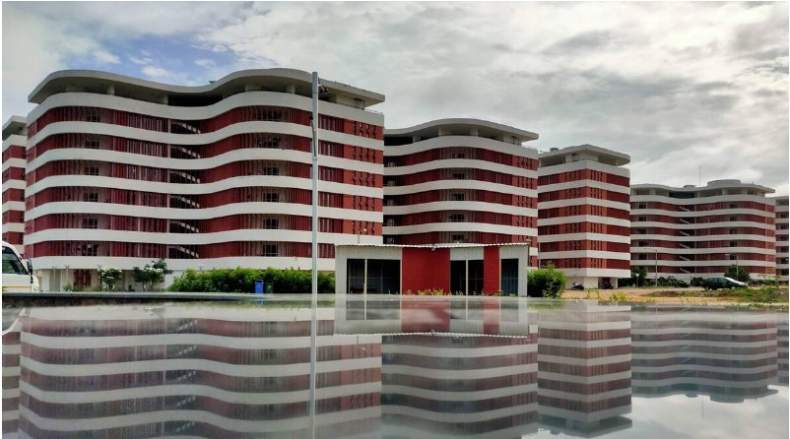

IIT Hyderabad Campus
Salient Features

Slide 2
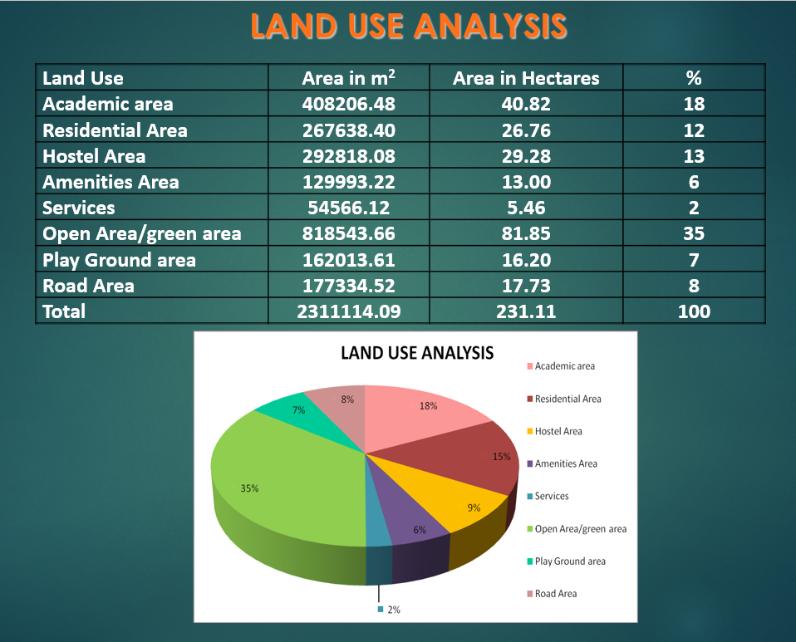
Campus Land Use Analysis

Slide 3
Salient Features of Campus
Length of Roads | 18.35 Km
Length of Walkways | 17.86 Km
Length of Cycle Tracks | 13.8 Km
Length of Swales | 14.84 Km
Capacity of Artificial Lakes | 3,93,46,000 Litres

Slide 4
Hostels Capacity
Name of The Buildings | Capacity
Hostels in Phase 1 ( Block A to J) | 1960 Boarders
Hostels in Phase 2 | 2432 Boarders
Precast Hostel (Ramanuja) | 336 Boarders
Married Student Hostel | 84 Families
PSH Hostels | 534 Boarders
Total Capacity of Existing Hostels | 5346 Boarders
Hostels under Construction | Capacity
Precast Hostel 1,2,3 | 996 Boarders

Slide 5
Areas of Hostels Blocks
Name of The Buildings | Built up Area
Hostels in Phase 1 ( Block A to J) (Including Pavilions) | 57,160 Sqm
Hostels in Phase 2 ( 8 Nos of Blocks) (Including Pavilions) | 71,680 Sqm
Precast Hostel (Ramanuja) | 4,799 Sqm
Married Student Hostel | 6,850 Sqm
PSH Hostels | 4,425 Sqm
Total Area of Existing Hostels | 1,44,914 Sqm
Hostels under Construction | Built up Area
Precast Hostel 1,2,3 | 15096 Sqm

Slide 6
Areas of Academic Blocks
Name of The Buildings | Built up Area
A Block- Chemical Engineering | 18,499 Sqm
B Block- Civil Engineering | 16,394 Sqm
C Block- Mechanical Engineering | 18,964 Sqm
Chemistry Engineering | 10,063 Sqm
Metallurgical and Materials Science Engineering | 5,997 Sqm
Biotech Bio-medical Engineering | 8,552 Sqm
Electrical & Computer Science Engineering (AD2) | 19,682 Sqm
Maths, Physics, Liberal Arts (AD3) | 17,584 Sqm
Department of Design | 6,490 Sqm
Total Area of Existing Academic Blocks | 1,22,225 Sqm

Slide 7
Areas of Residential Buildings
Name of The Buildings | Built up Area
ST1 & ST2 | 17,148 Sqm
FT 1,FT2,FT3 | 39,438 Sqm
Total Area of Existing Residential Buildings | 56,586 Sqm
Residential Buildings under Construction | Built up Area
FT1A | 17090 Sqm
FT1B | 17090 Sqm
ST1A | 8886 Sqm
ST2A | 10155 Sqm
ST2B | 10155 Sqm
Total area of upcoming Residential Buildings | 63,376 Sqm

Slide 8
Areas of Various Buildings on Campus
Name of The Buildings | Built up Area
Guest House | 30,123 Sqm
Sports Complex | 30,891 Sqm
Knowledge Centre | 9,325 Sqm
Technology Incubation Park | 19,559 Sqm
Technology Research Park | 19,559 Sqm
Convention Centre | 17,124 Sqm
Research Centre Complex | 12,325 Sqm
Lecture Hall Complex | 15,763 Sqm
Core Lab | 2,805 Sqm
Administrative Building | 6,840 Sqm
Dining Hall | 4,637 Sqm
Health Care Centre | 1,600 Sqm
Campus School | 3,090 Sqm

Slide 9
Architectural Features of Various Buildings
on Campus

Slide 10
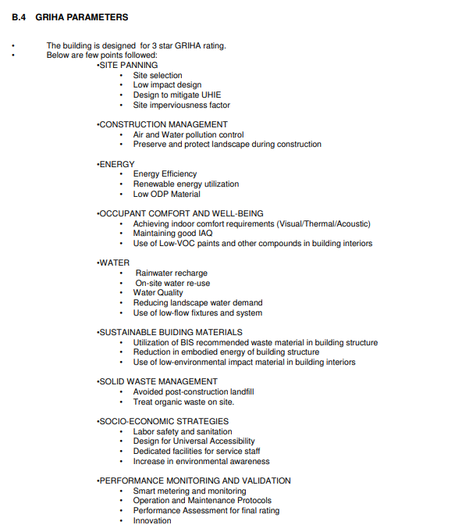
GRIHA Parameters for Buildings

Slide 11
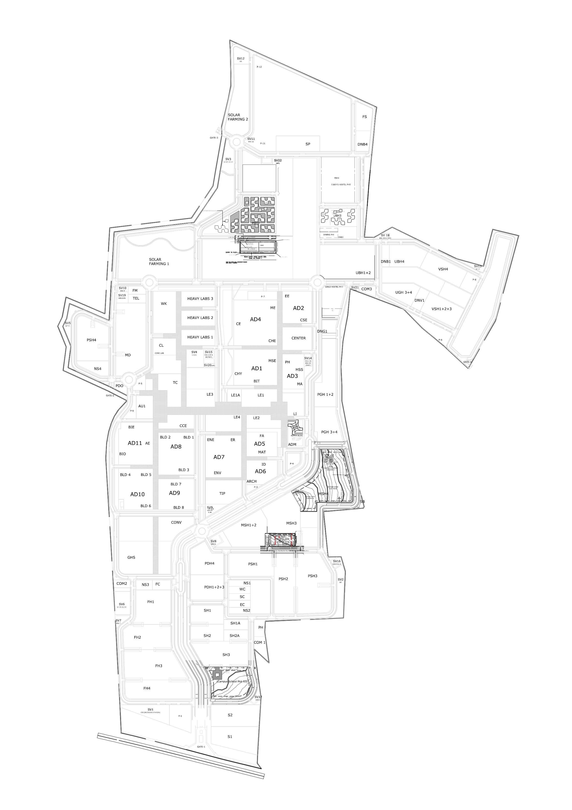
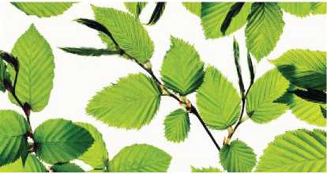
Architectural Features of Hostels
SITE PLAN
OLAR
FARMING 2
DNB4
DESIGN CONCEPT
Inspired by the image of leaves, twigs and branches growing from the same tree with the same family roots, these leave-clusters forming a new pattern of community living, connected with each other through its essential architectonical elements, the central common green and paths.
BOY'S
HOSTEL
SOLAR FARMING 1
DINING HALL
VSH4 -12110.BOSQM
BOYS HOSTEL PHI (JBH1 + 2
VSH4
WK
HEAVY LABS 3

Slide 12
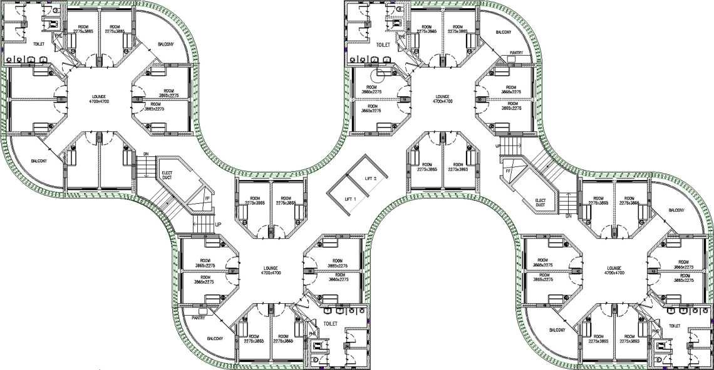
Architectural Features of Hostels
Two clusters are linked with; one central access with main staircase and one lift (13 persons). Two of those staircases/ Lifts are provided per one building and ensure the sufficient access as well as escape exit

Slide 13
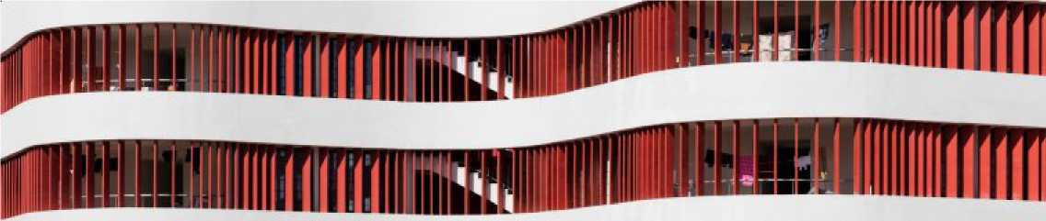
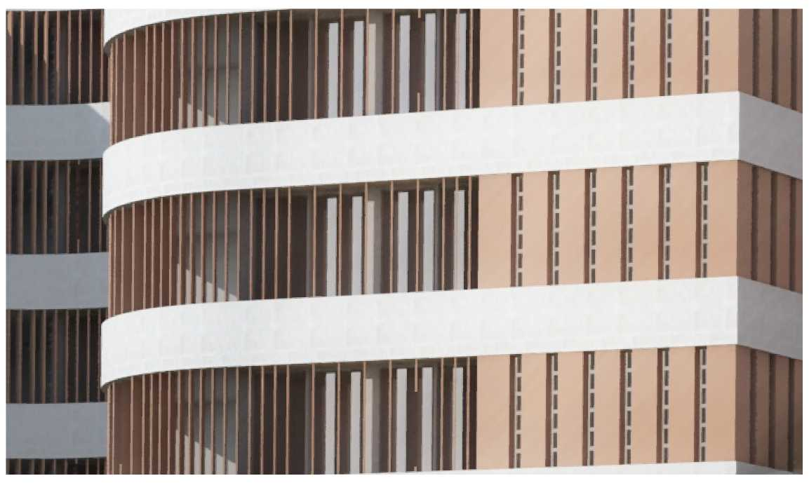
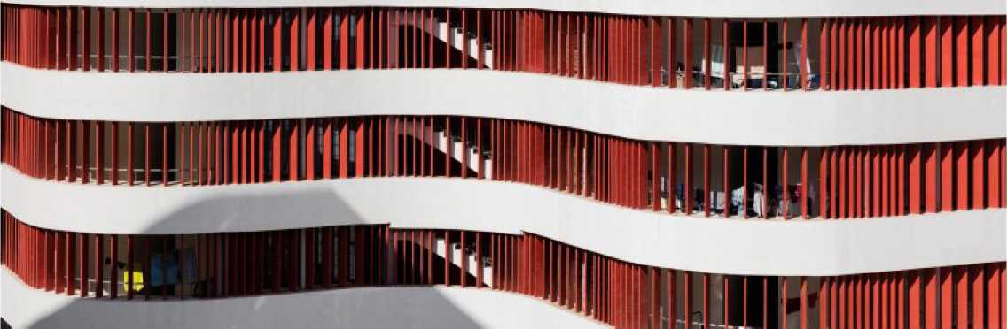
Architectural Features of Hostels
The Facade is characterized by vertical fin elements (ferro-cement/ concrete) with shading performance and create more privacy as well within the open areas.
The fins angles vary in two modes according to direction to reduce solar impact.
Even the toilets are ventilated and are not distuigshed in the facade by the fins.

Slide 14
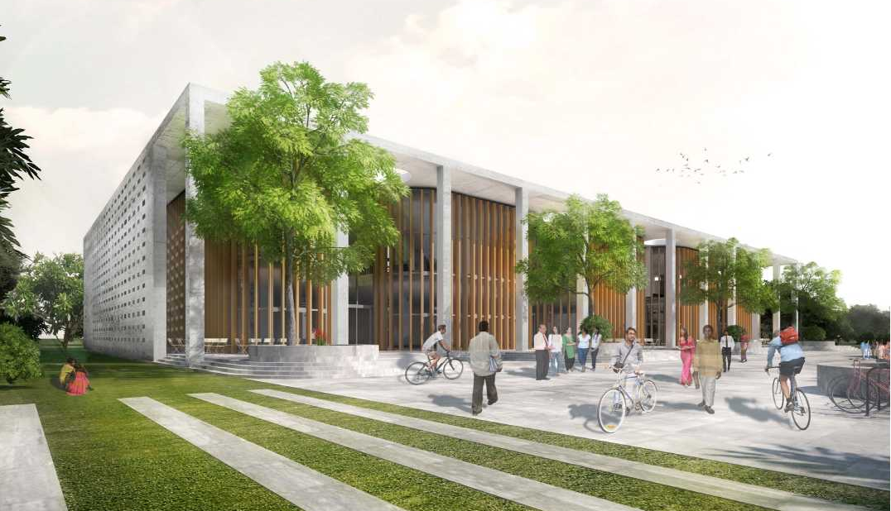
Architectural Features of Dining Hall
KEY FACTS
- Levels: G + 1 having height of 13M
- BUA: 4.640 sqm
- Number seats per building: 1000
- Number dishes per building: 2500
- Building Code: classified as Group C - Institutional
- Toilets required (NBC 2016):
6 WC + 12-14 urinals + 1 WB for visitors/
1 WC + 1 WB for staff
- Toilets provided:
10 WC + 14 urinals + 8 WB for visitors
2 WC + 2 WB + changing rooms for staff
- Firefighting: Sprinklers in dining area, firefighting shaft + fire escape staircase (NBC 2016)

Slide 15
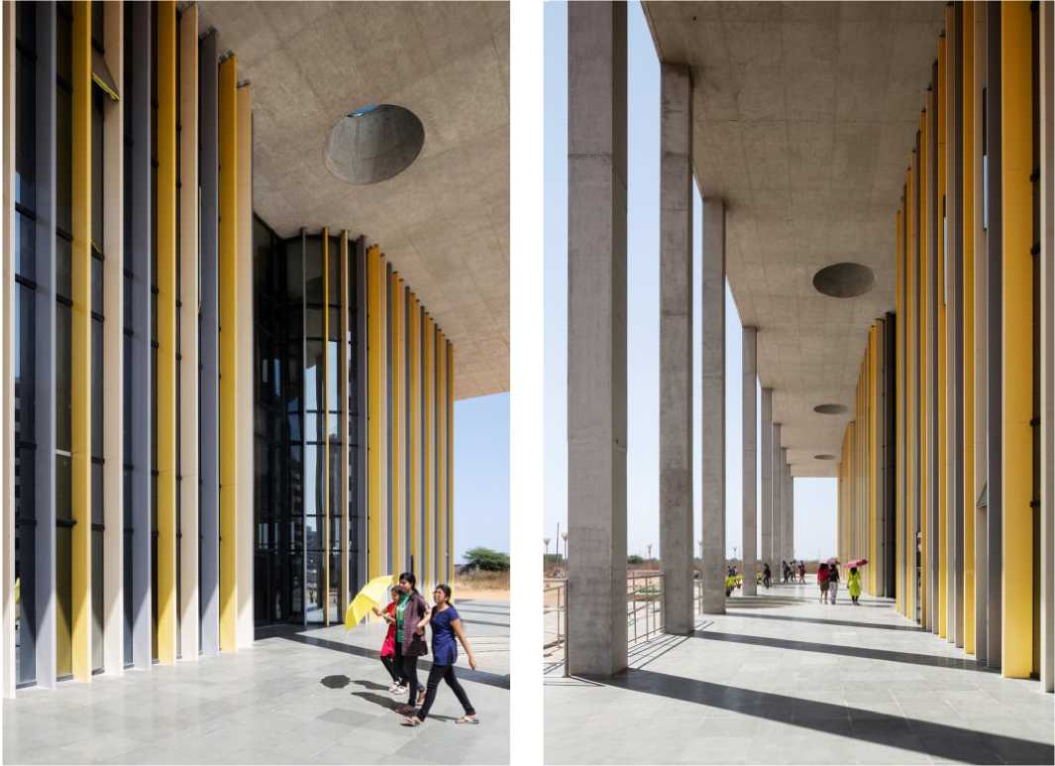
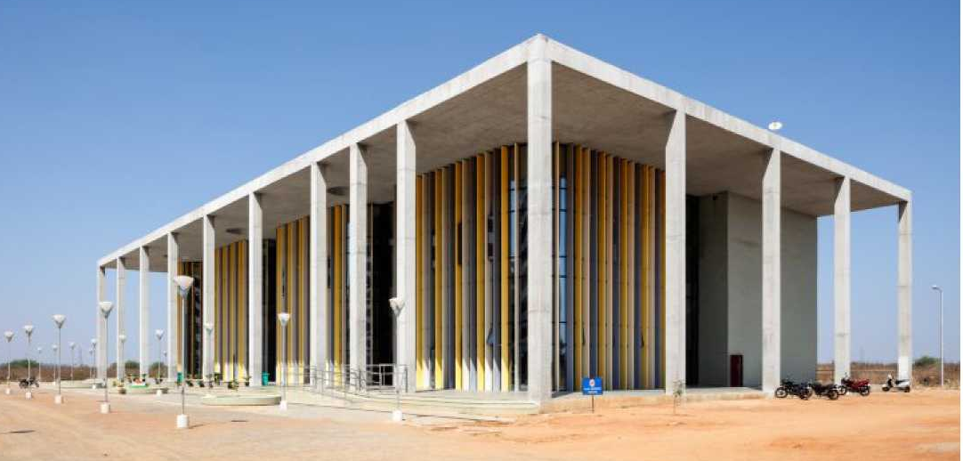
Architectural Features of Dining Hall
VS System: It is a point supported curtain wall system without any transoms, absolutely nil transoms.
FACADE
The mainly glass facade under the roof with its partial circular cut-outs is curved shaped and partly openable during the pleasant months after monsoon.
Gallery seating on first floor facing the plaza is following the same shape and interacts with the design of the hostels.

Slide 16
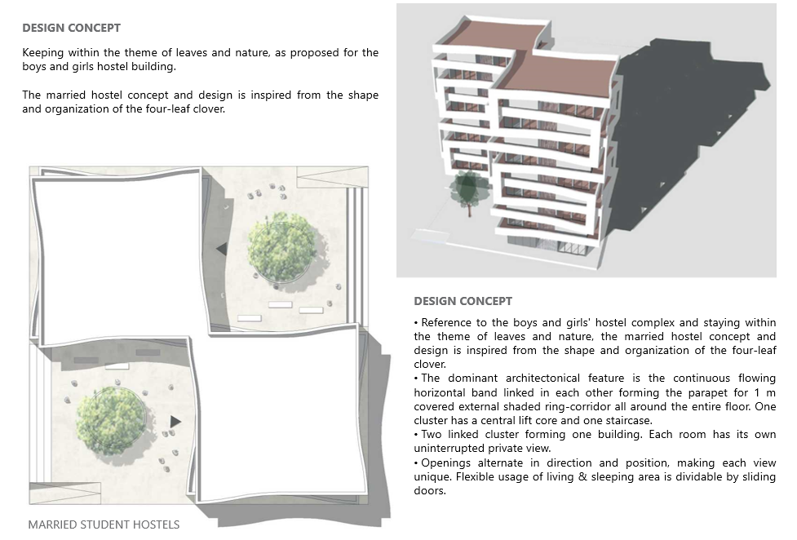
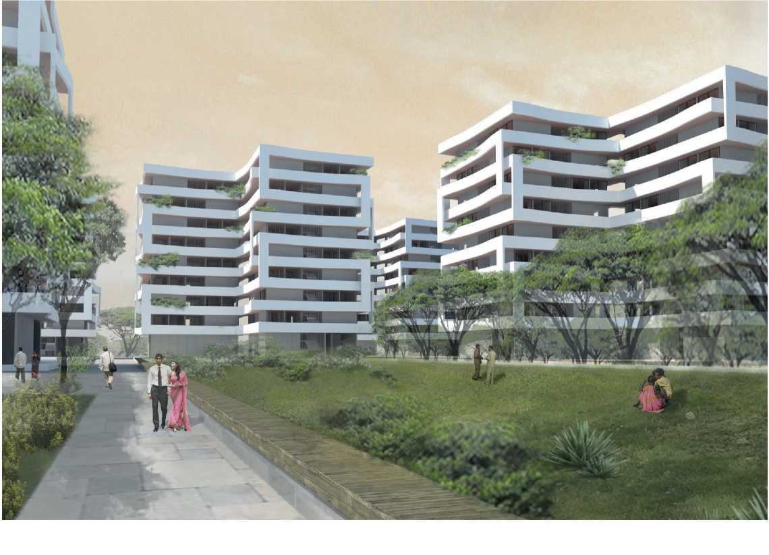
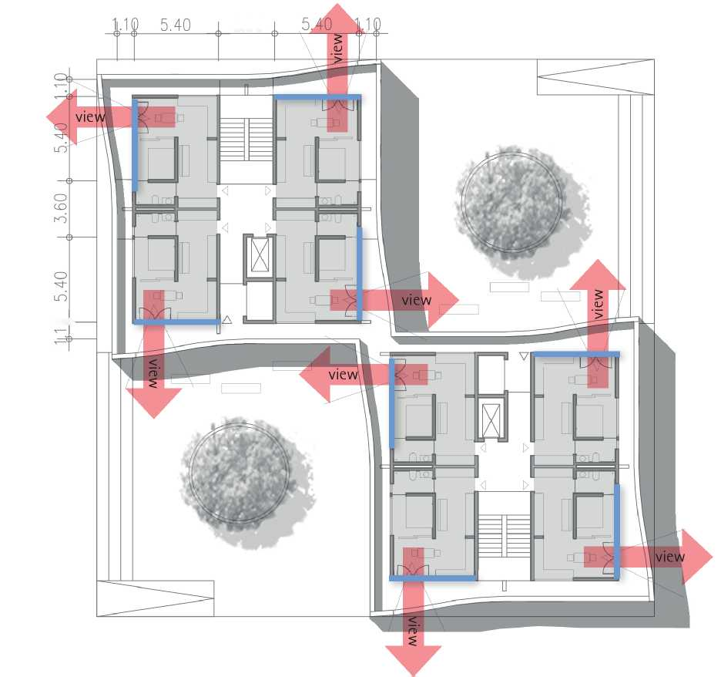
Architectural Features of Married Student Housing

Slide 17
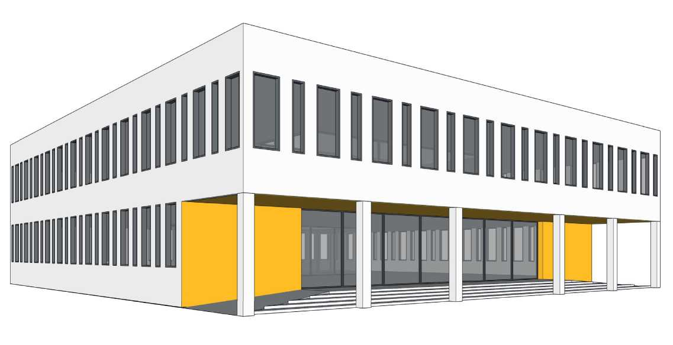
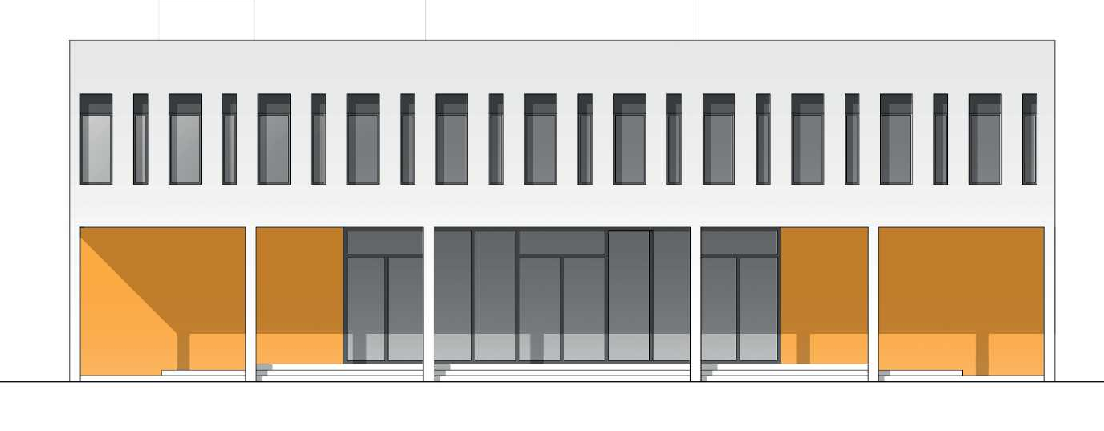
Architectural Features of Health Care Centre
DESIGN CONCEPT
HCC has simple cubical form and clear structure of building which follows function and easy orientation.
Main northern entrance to the building opens with welcoming reset colonnade entrance lobby and waiting launch.
Square building with singly loaded wide corridors and central open to sky courtyard is a basic circulation of Health care centre.
A second green open terrace is located in level 01 above the waiting lounge. Courtyard planning enhances natural light and ventilation of the hospital building. Green space create pleasant atmosphere in the building.
It accommodates 22 beds including 4 beds in casualty, 4 OPDs with rotational visiting doctors, 1 operation theatre with pre-op and post-op, attached toilet, changing rooms, equipment rooms, scrub area.
Each floor has common ladies and gent's toilet. Every ward, duty doctor's room and nurses changing room has attached toilets.
Reception, admin area, canteen Diagnosis areas are placed at ground floor. Casualty at ground floor has separate entrance through ramp with sufficient movement space for ambulance. OPD and casualty patients' entry segregated purposely.

Slide 18
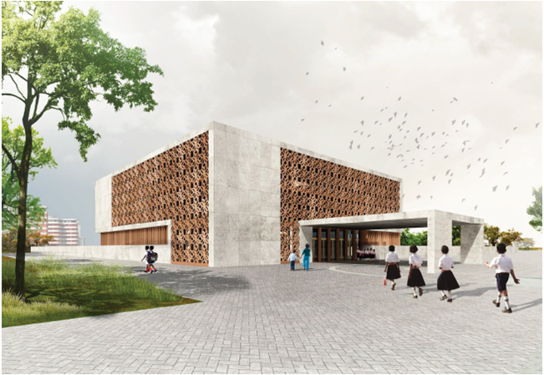
Architectural Features of Campus School
DESIGN CONCEPT
The clear, simple & functional structured cube formed school building is designed in ground +2 levels around a central green open court yard and can accommodate 600 students in 12 classrooms.
The open spacious entrance lobby allows the view right through the central court yard and the auditorium into the garden.
The auditorium can be opened up to both sides by sliding glass facade and connects the inside with the garden landscape for special functions.
Natural ventilation & lighting via court yard and all open corridors in upper levels will reduce the overall energy consumption and assure thermal comfort.

Slide 19
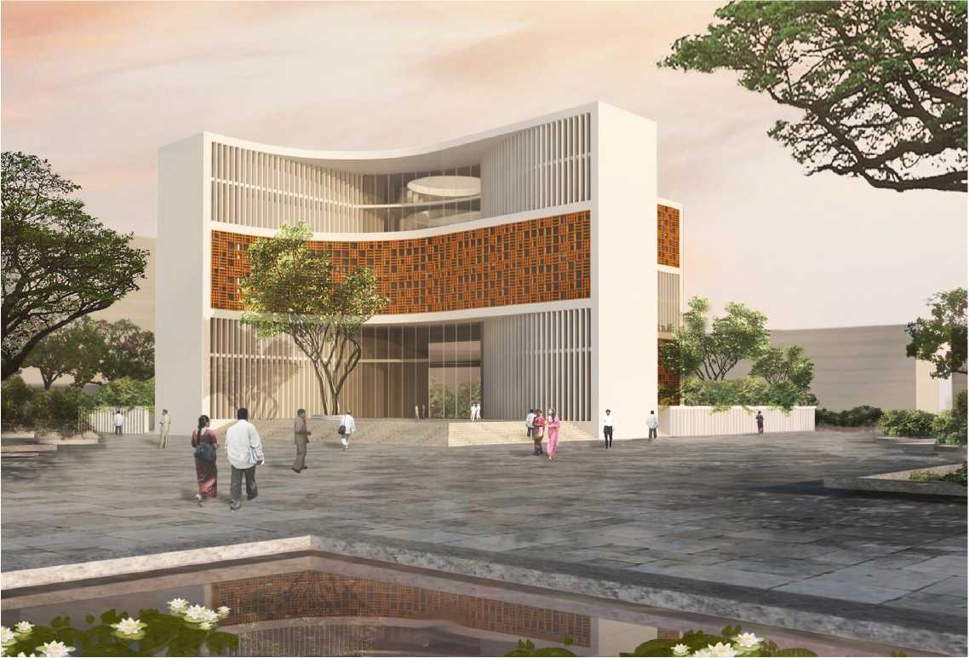
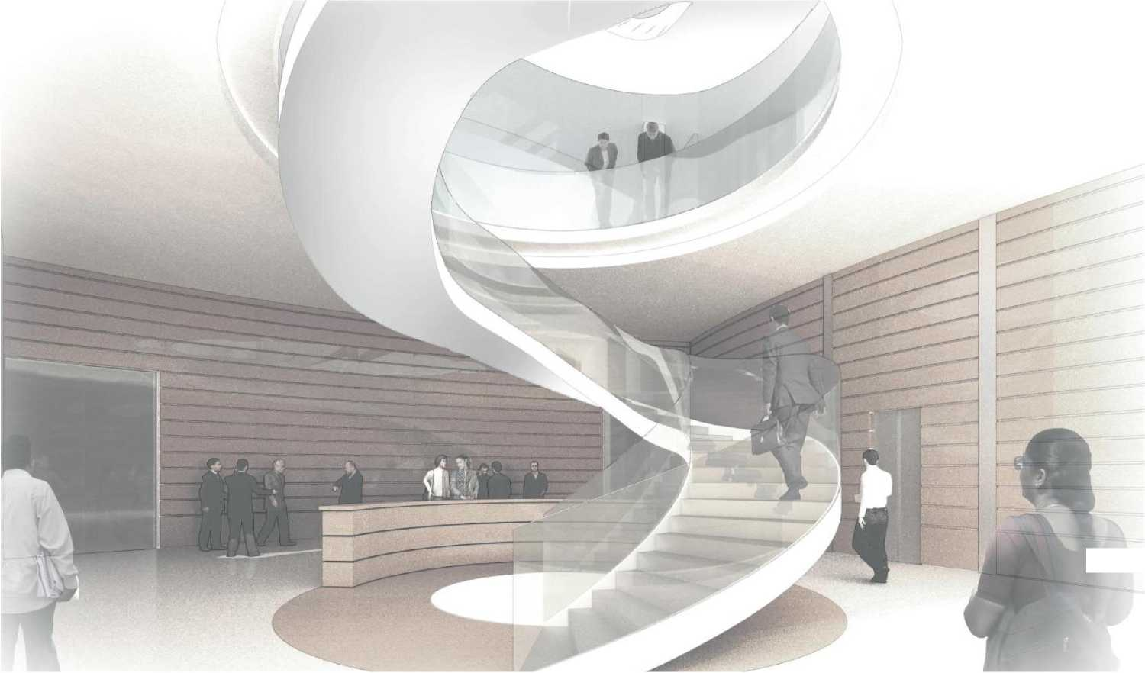
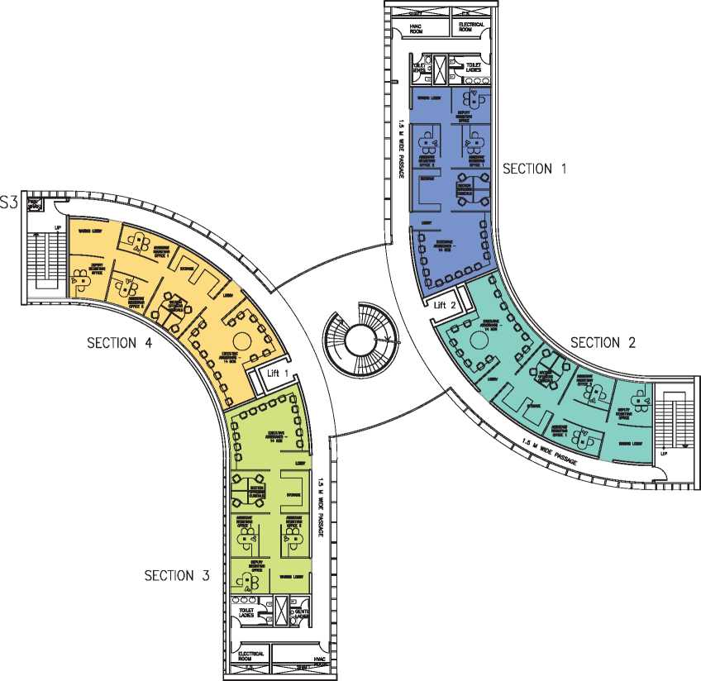
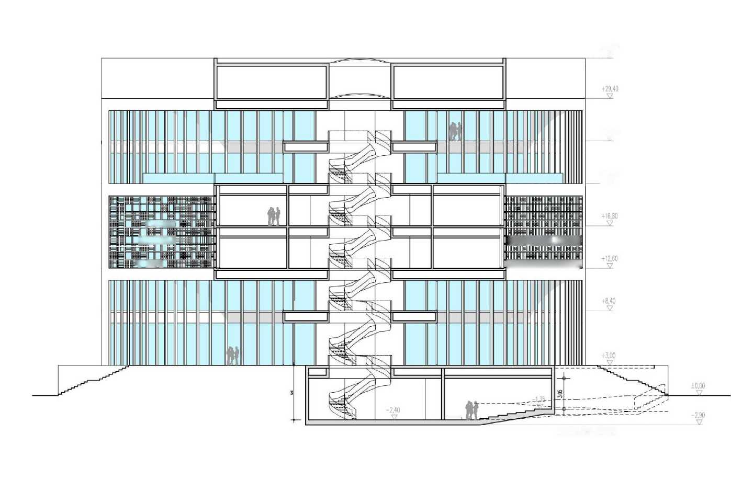
Architectural Features of Admin Building
The lower ground + Ground floor + 5 storey building with a height of about 33 m (30 M above ground ) covers a built up area of about 6500 sqm accessed by 2 elevators - each having a carrying capacity of 15 persons.
FACADE
The Facade is characterized by vertical fin elements (ferro-cement/ concrete) with shading performance, combining two levels (ground & 1st floor/ 4th & 6th), while 2nd & 3rd are combined by a colored Jali with patterns for shading.
Separate lift for disabled are provided from street level to ground & lower ground floor level on both sides of building.
Toilets provided on external side of the building

Slide 20
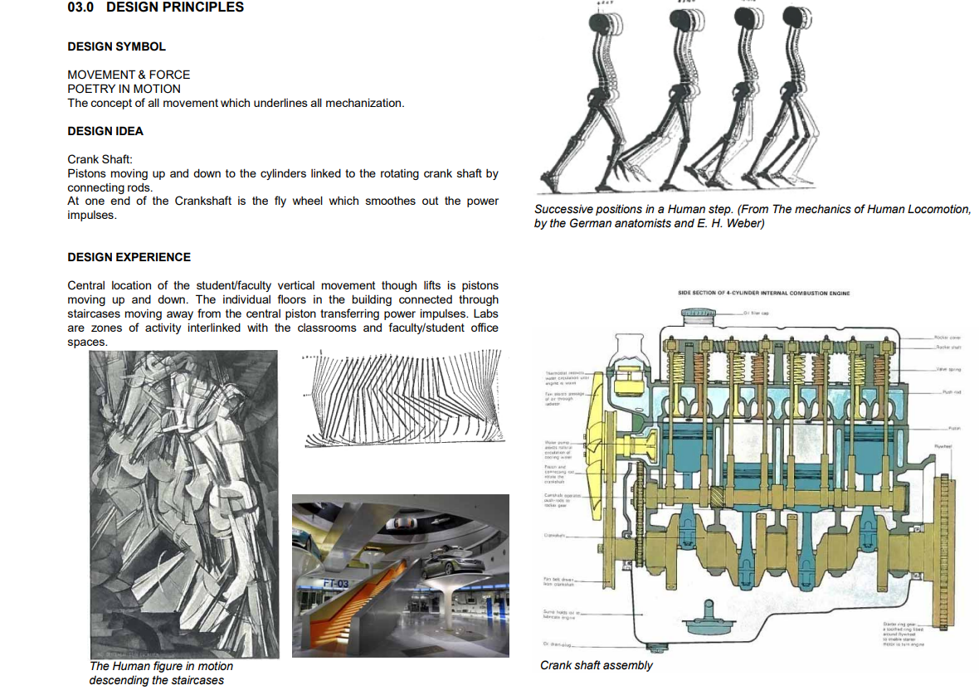
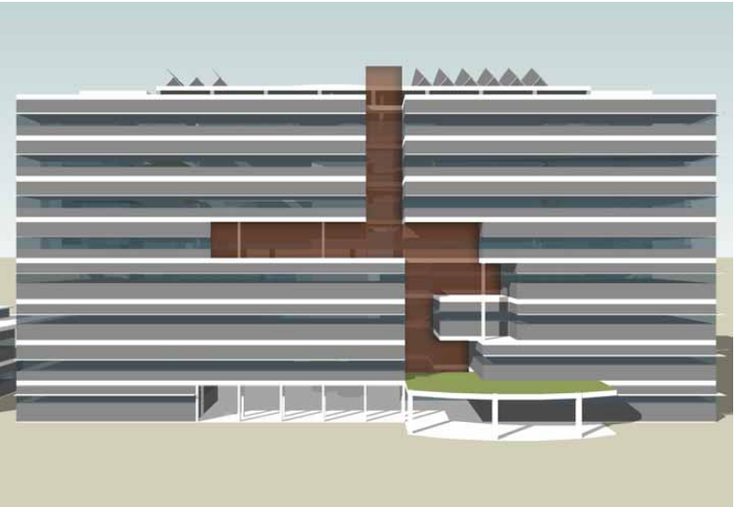
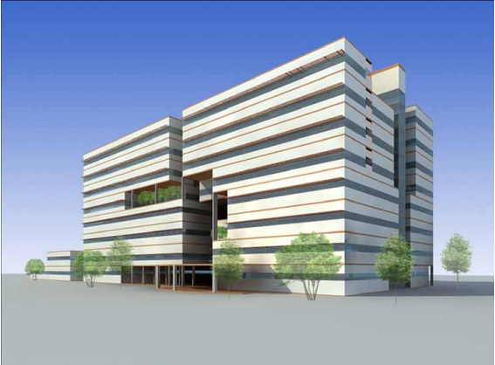
Architectural Features of Academic Block C (Mechanical Engineering)

Slide 21
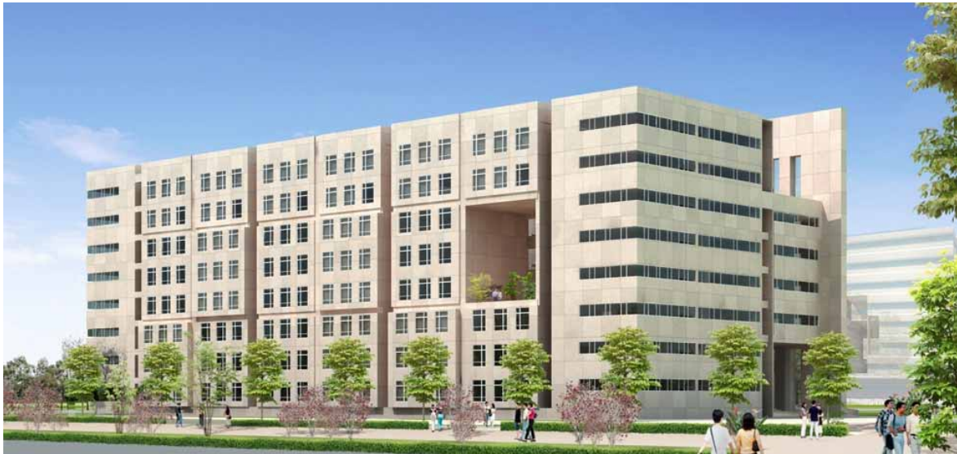
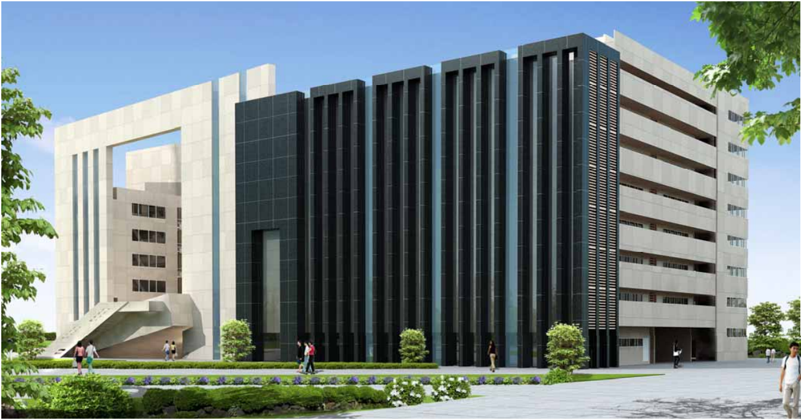
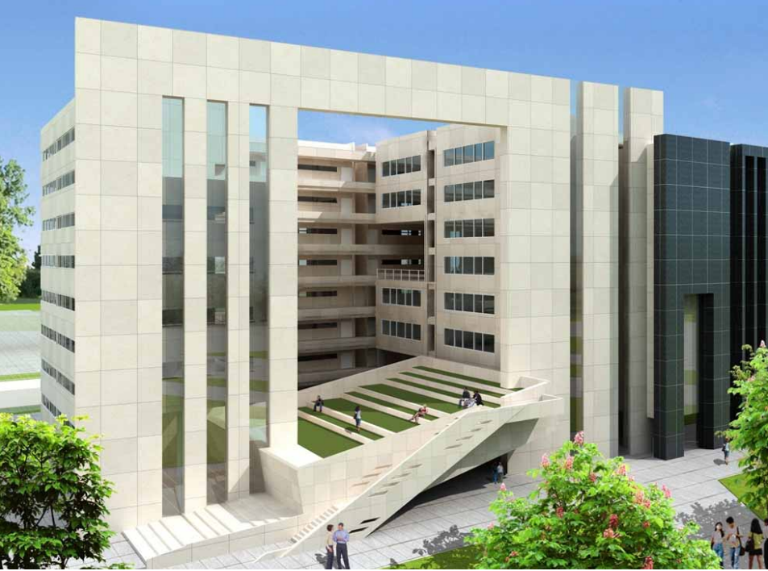
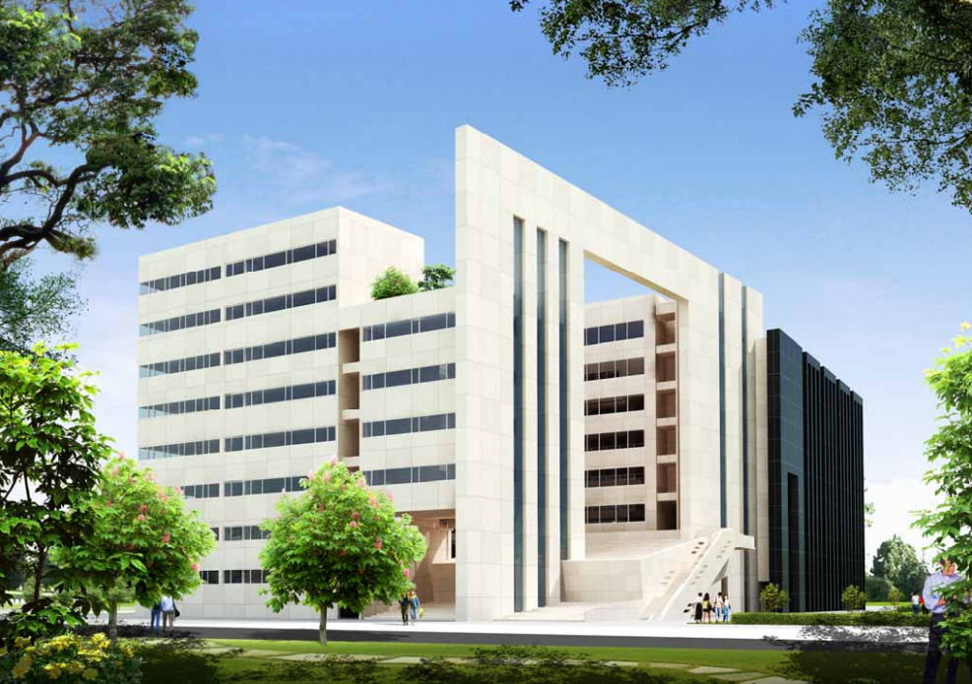
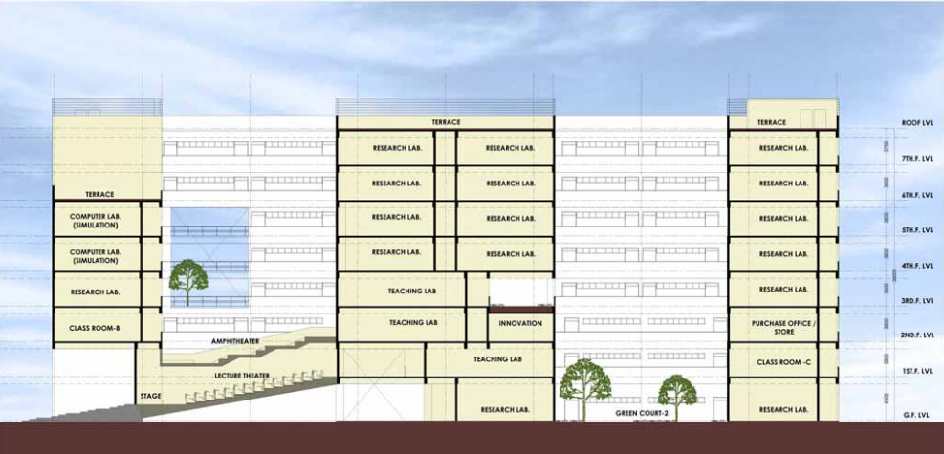
Architectural Features of Academic Block A (Chemical Engineering)

Slide 22
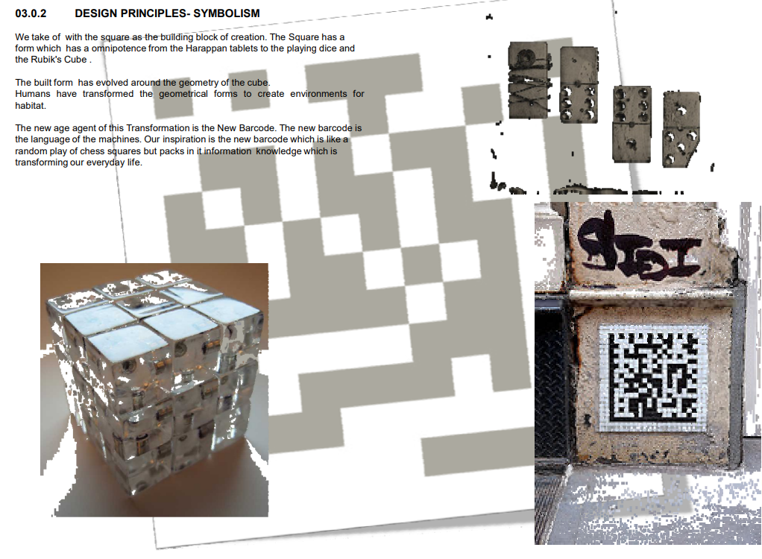
Architectural Features of Academic Block A (Chemical Engineering)

Slide 23
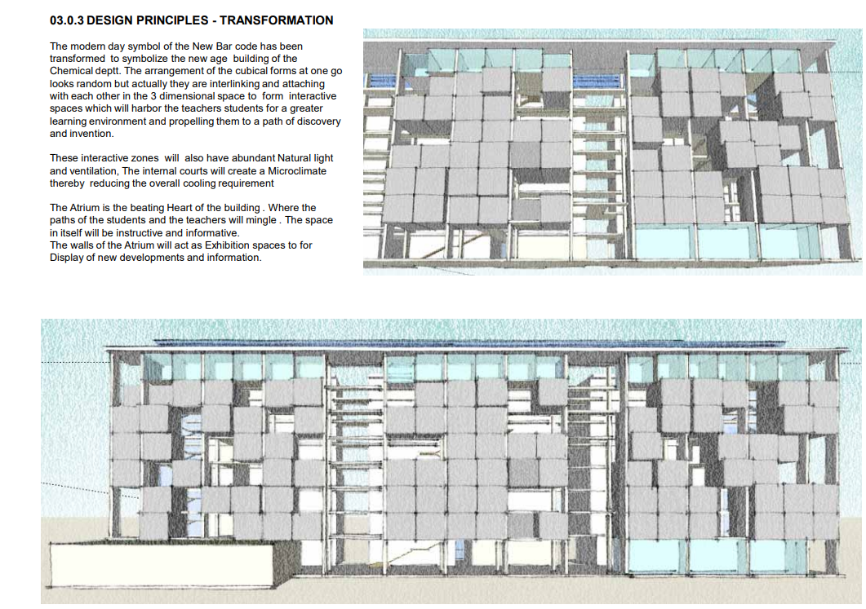
Architectural Features of Academic Block A (Chemical Engineering)

Slide 24
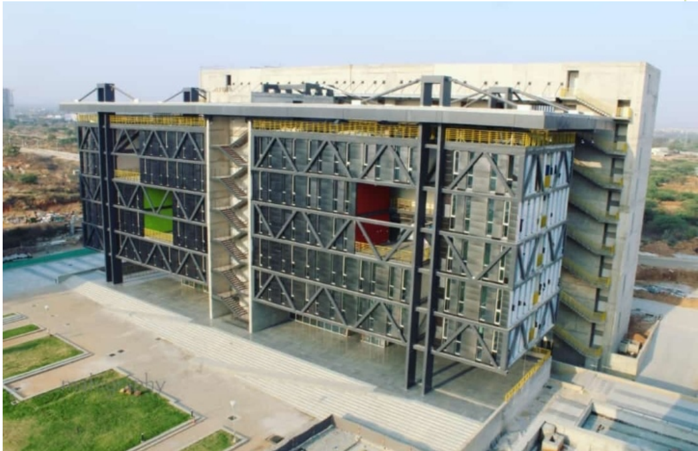
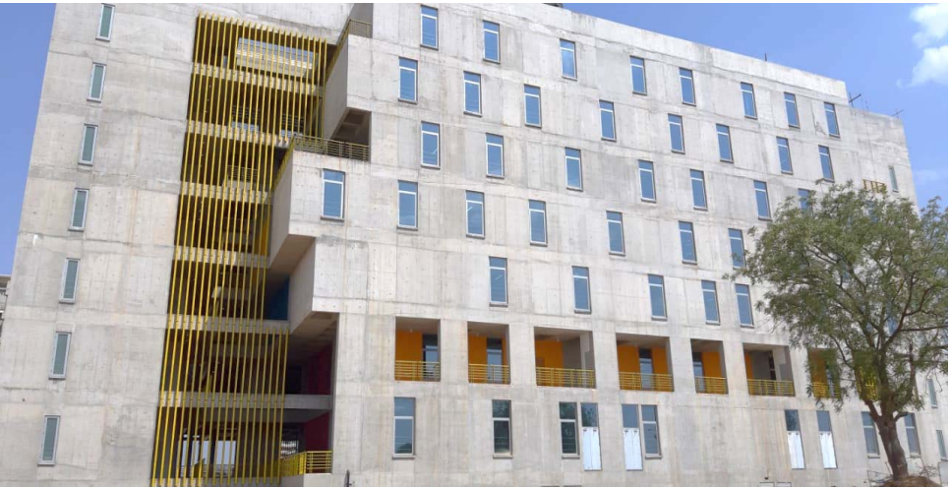
Architectural Features of Academic Block B ( Civil Engineering)

Slide 25
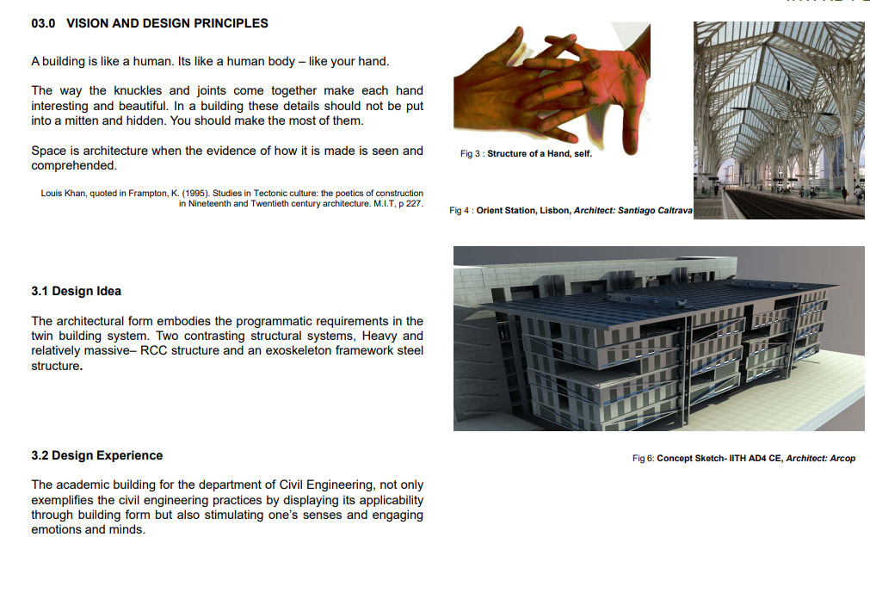
Architectural Features of Academic Block B ( Civil Engineering)

Slide 26
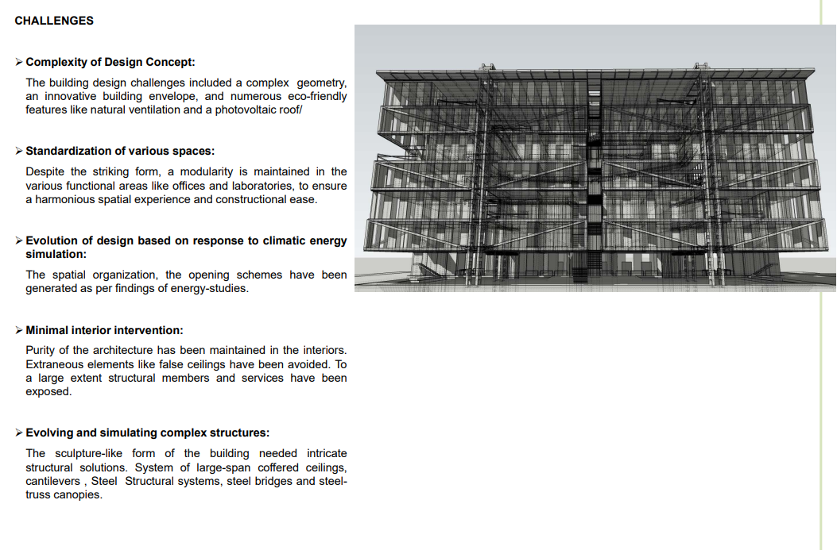
Architectural Features of Academic Block B ( Civil Engineering)

Slide 27
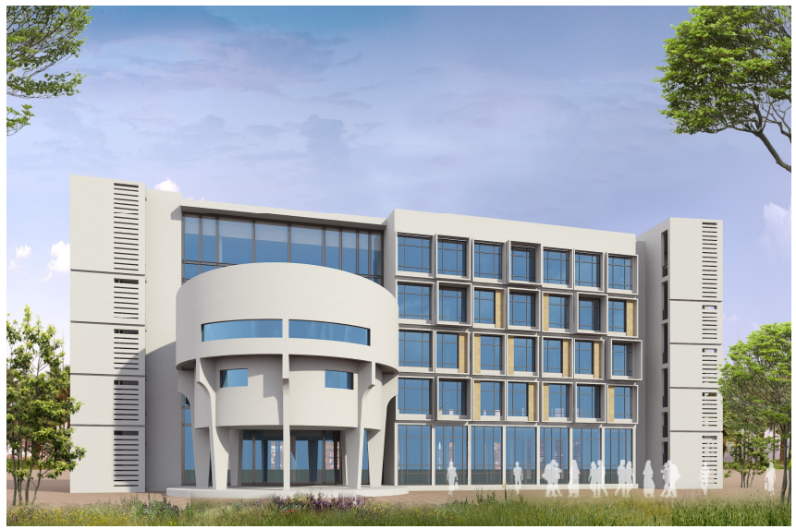
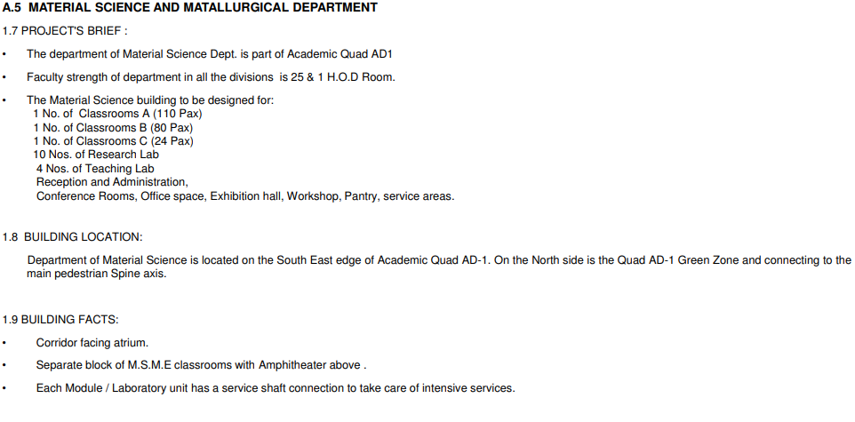
Architectural Features of AD1 (MSME Building)

Slide 28
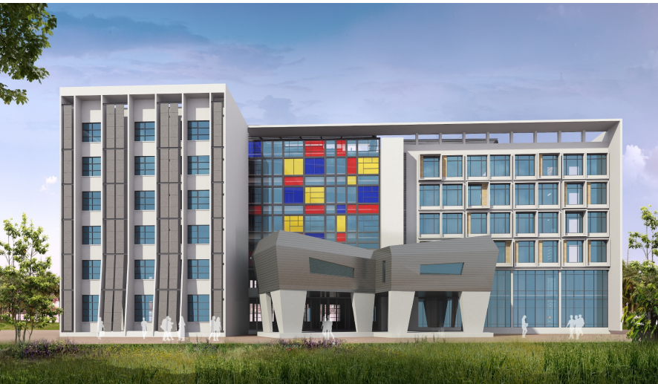
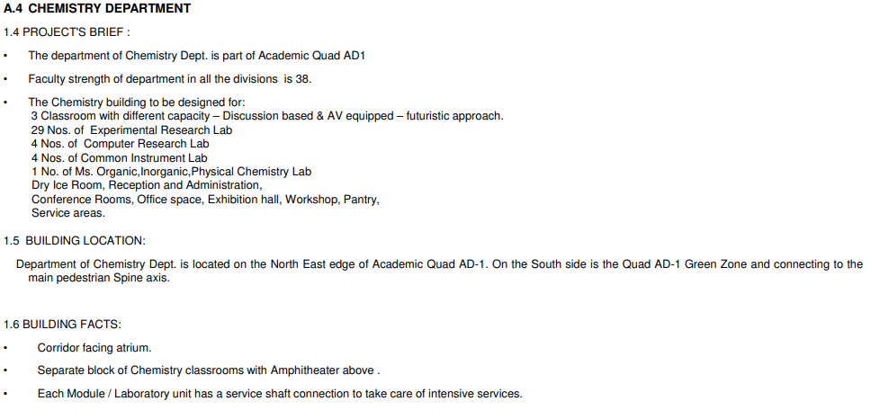
Architectural Features of AD1 (Chemistry Building)

Slide 29
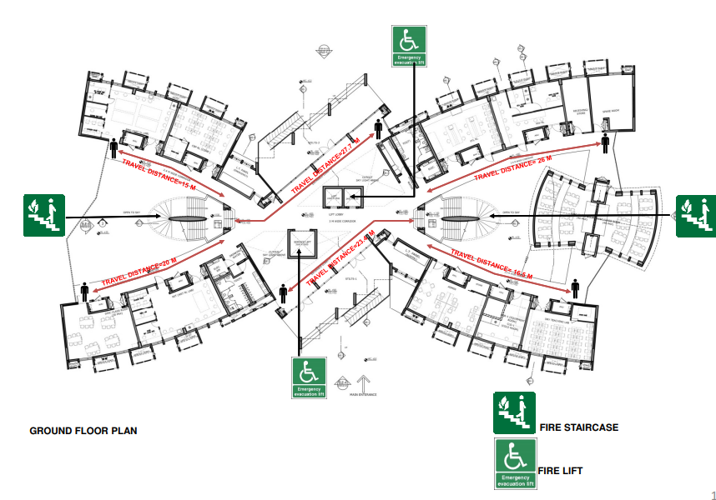
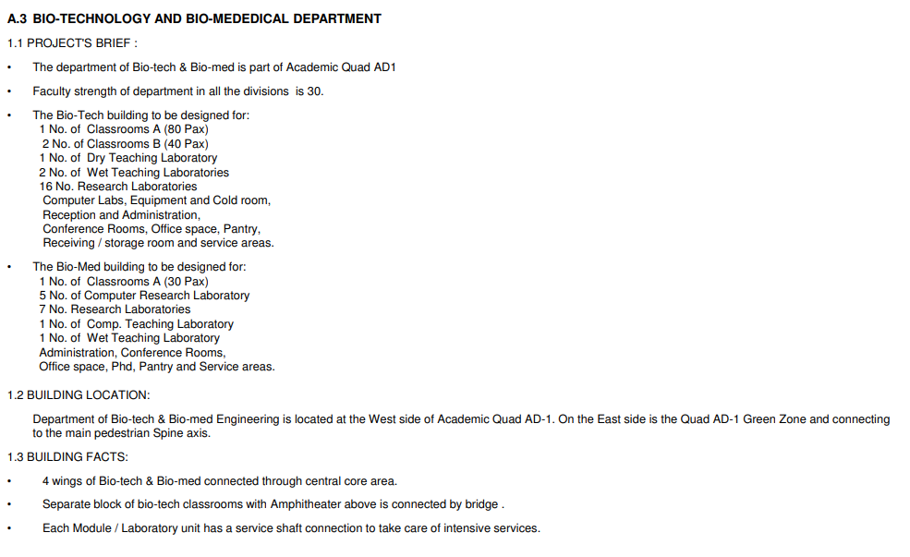
Architectural Features of AD1 (BTBM Building)

Slide 30
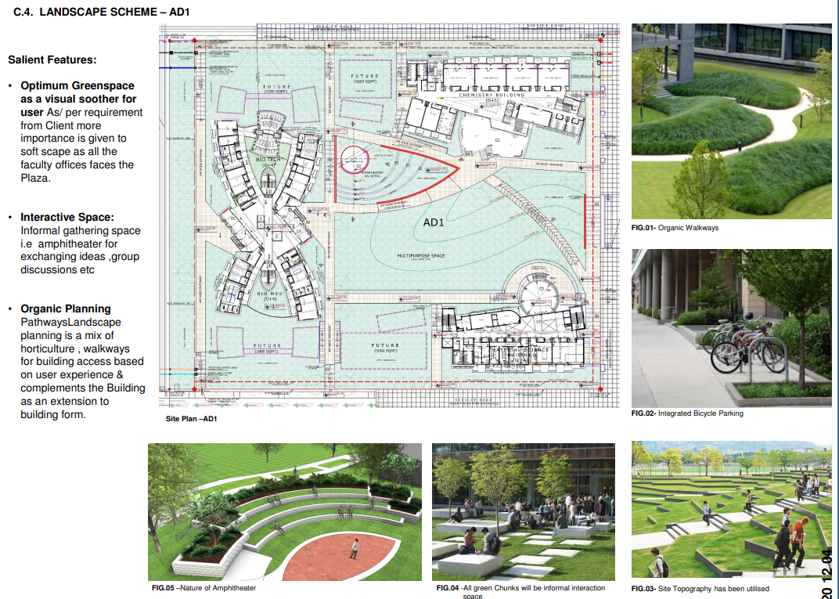
Architectural Features of AD1 Landscaping

Slide 31
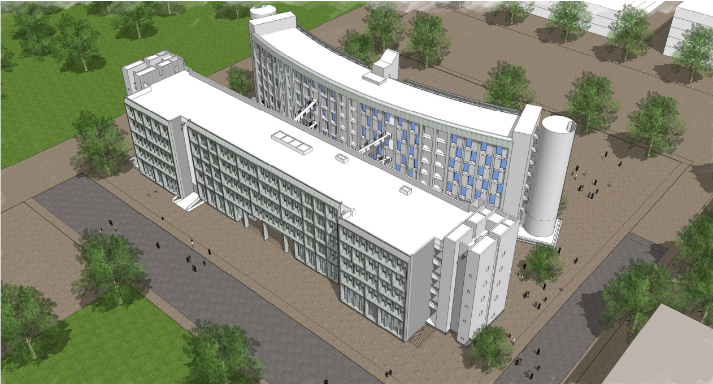
Architectural Features of AD2 (Computer Science & Electrical Engineering )
Approach for planning The complex has been designed with the idea of having clear demarcated spaces for functional, service and circulation areas in separate bays for ease of movement and providing mechanical/electrical services to the functional spaces. The complex is further divided into two buildings interconnected with bridges, one housing the labs and the classrooms while the other houses the faculty offices. The courtyard created between the two buildings acts as an interaction space for students and faculty while bringing in shaded natural light and ventilation into the building.

Slide 32
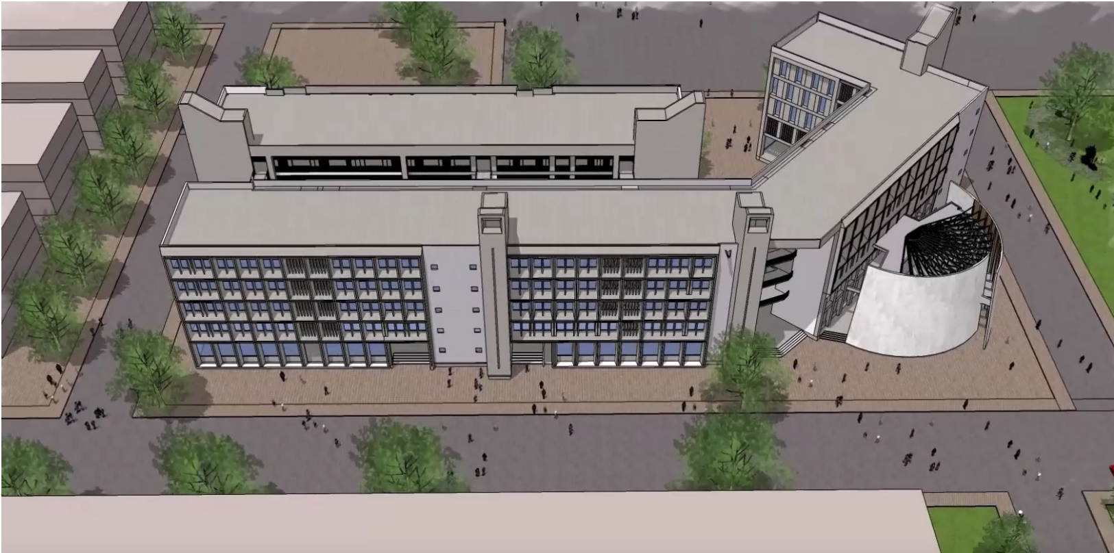
Architectural Features of AD3 (Physics ,Maths , & Liberal Arts )
The complex has been designed with the idea of having clear demarcated spaces for functional, service and circulation areas in separate bays for ease of movement and providing mechanical/electrical services to the functional spaces. The complex is further divided into two buildings interconnected with bridges, one housing the labs and the classrooms while the other houses the faculty offices. The courtyard created between the two buildings acts as an interaction space for students and faculty while bringing in shaded natural light and ventilation into the building.

Slide 33
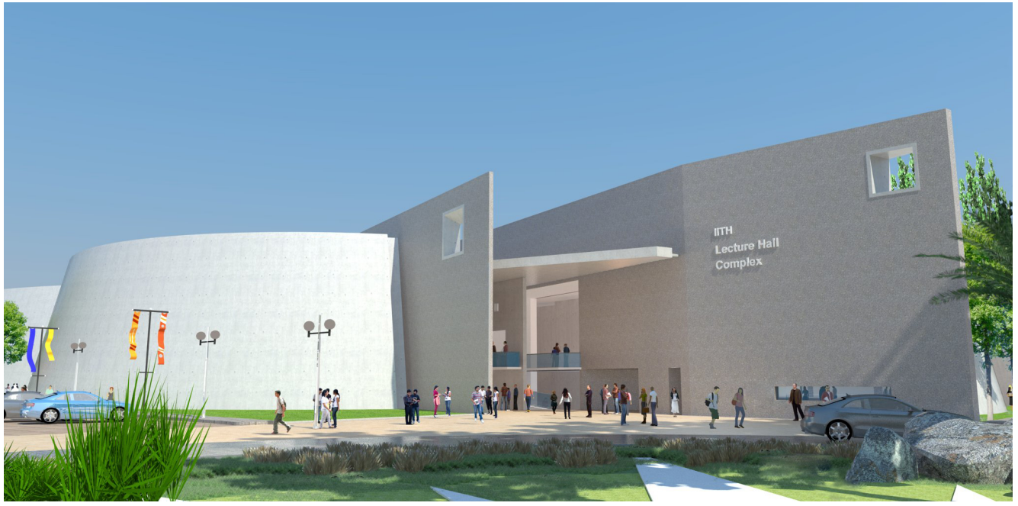
Architectural Features of Lecture Hall Complex

Slide 34
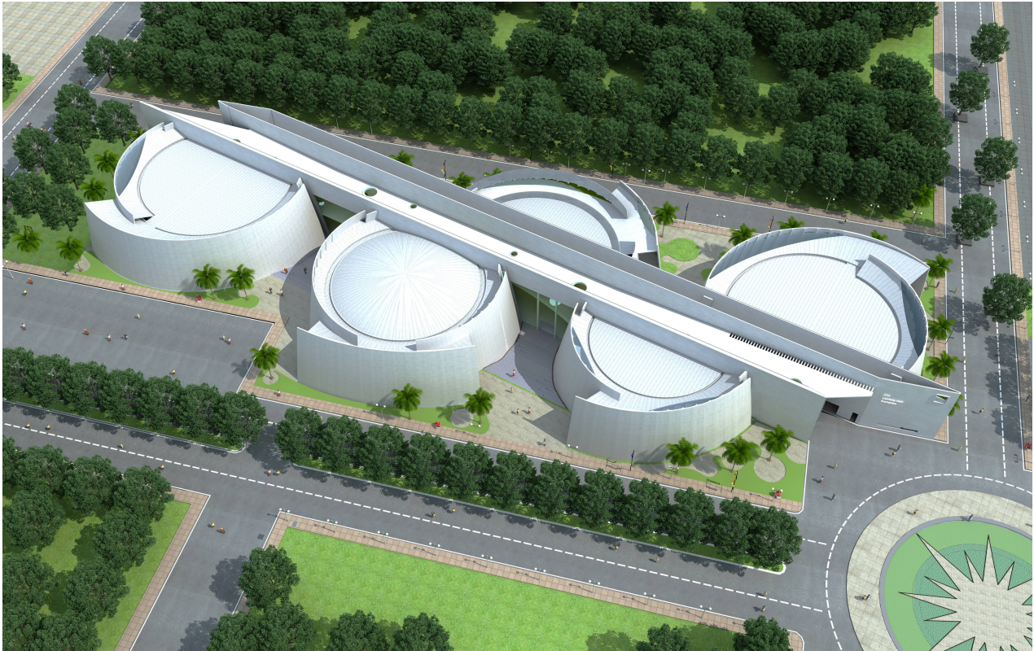
Architectural Features of Lecture Hall Complex

Slide 35
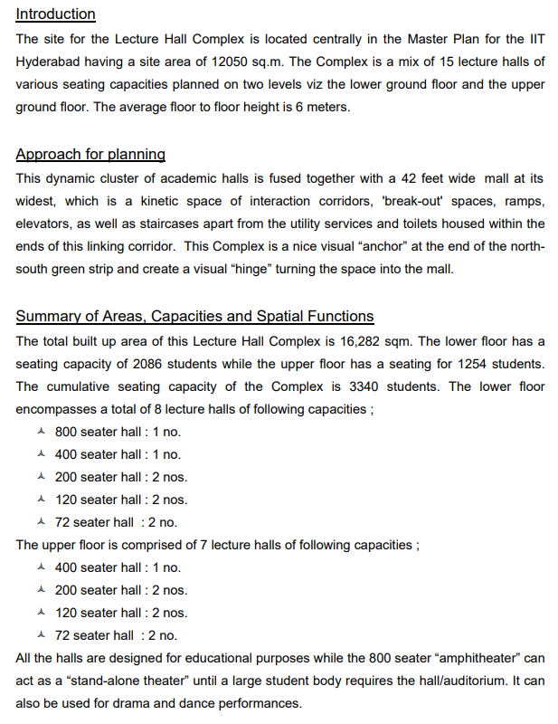
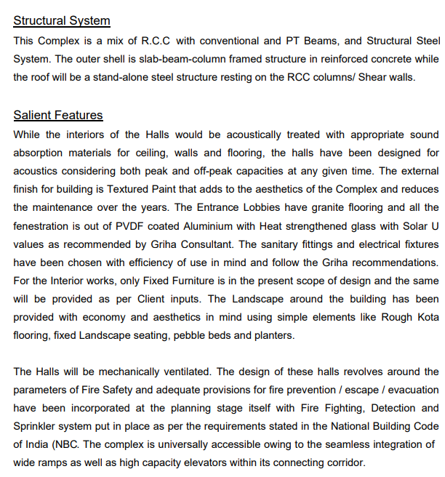
Architectural Features of Lecture Hall Complex

Slide 36
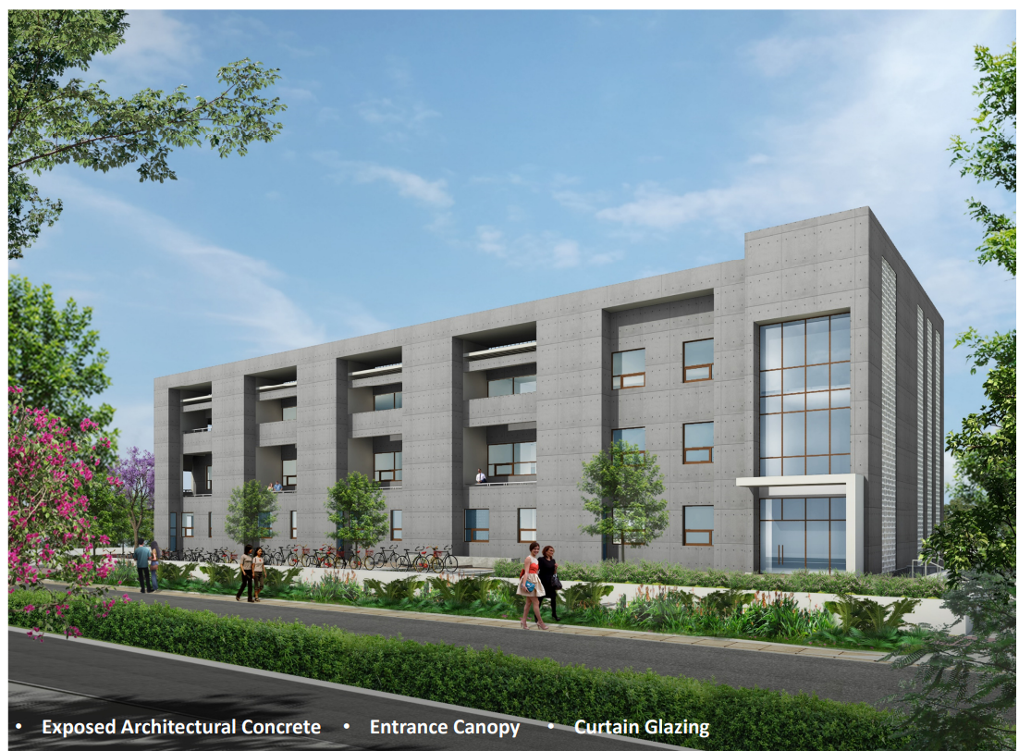
Architectural Features of Core Labs

Slide 37

Architectural Features of Core Labs

Slide 38

Architectural Features of Department of Design

Slide 39

Architectural Features of Department of Design

Slide 40

Architectural Features of Department of Design
• The Building has been designed as an open building concept. The Building Steps up and appears like a giant stepped block.
• The building has wings rising from Single floor to upto five floors.
• An Atrium Cuts through the building.
• The Building Services are mostly placed below the stairs and on Final terrace floor

Slide 41

Architectural Features of Faculty Housing

Slide 42

Architectural Features of Faculty Housing

Slide 43

Architectural Features of Staff Housing

Slide 44


Architectural Features of Staff Housing

Slide 45

Architectural Features of Guest House

Slide 46

Architectural Features of IGH

Slide 47
Architectural Features of IGH
Ground + 5 Guest house building at the edge of a 4.7 mts. deep water retention basin.
A total of 200 rooms in a combination of single rooms, double rooms, suits & super suits.
All floors are different as rooms & corridors are staggered in plan
Some upper floor rooms are cantilevered by up to 9.0 mts.
Substantial use of precast concrete panels at all floors in a combination of solid panels and partly glazed panels.
Courtyard with Piloti features.
Combination of exposed concrete finish & plaster and painted surfaces.
Site Area 29600 sq.mt
Building Foot print 5764 sq.mt
Site Development 10570 sq.mt
Total Built -Up Area 30123 sq.mt
Retention Basin 13625 sq.mt

Slide 48

Architectural Features of Sports and Cultural Complex
SPORTS AND CULTURAL COMPLEX
CULTURAL CENTRE
BADMINTON HALL
SUB ARENA
MAIN ARENA
CRICKET FIELD
FOOTBALL FIELD
AMPHITHEATRE
ACTIVITY ROOM

Slide 49

Architectural Features of Sports and Cultural Complex
Vegetation
Parking
Circulation
Site Area 110600.50 sq.mt
Ground Cover 28400.00 sq.mt
External Development 82200.50 sq.mt
Amphitheatre 5190.00 sq.mt
Swimming Pool 3300.00 sq.mt
Total Built Up Area 30891.00 sq.mt

Slide 50
Architectural Features of Sports and Cultural Complex
ARCHITECTURAL FEATURES AND CHALLENGES:
Ground +1 structures with exposed concrete folded plate roofs.
Folded plate roofs span from between 35 and 49 mts.
256 no. fixed roof lights, 800mm diameter, within folded plate roofs
Extensive external & internal structural glazing in full folded plate spans at various locations.
Internal walls in fair faced precast concrete Designer Blocks in a combination of solid and glazed blocks.
Open Air Amphitheatre with 6mt Cantilever Pergolas of steel & aluminum combination.
Internal corridors false ceiling with combination of expanded metal & gypsum.
Courtyard staircase metal structure.

Slide 51


Architectural Features of Sports and Cultural Complex

Slide 52


Architectural Features of Sports and Cultural Complex

Slide 53
Architectural Features of Technology Incubation Park
TECHNOLOGY INCUBATION PARK
LOUNGE
GALLERY
DRY RESEARCH LAB
WET RESEARCH LAB
DRY INCUBATION LAB
SEMINAR ROOM

Slide 54





Architectural Features of Technology Incubation Park
Site Area 14,857.4 sq.mt
Foot print 5,190.6 sq.mt
Site Development 7324.4 sq.mt
Total Built -Up Area 19559.7 sq.mt
Vegetation
Pathways
Landscape
Roads & Parking

Slide 55
Architectural Features of Technology Incubation Park
ARCHITECTURAL FEATURES AND CHALLENGES:
Laboratory complex comprising of 7 different sized square footprint blocks interconnected by covered corridors.
Blocks with variation of G+1 to G+5 floors.
Entrance & Courtyard canopies in a combination of Glass & Steel.
Floors with variety of cantilevered slabs (spanning from 0.6mt to 1.5mt).
Internal Courtyard with Tensile structure.
All internal corridors with Steel columns.
Combination of exposed concrete finish & painted plaster surfaces.
Internal corridors false ceiling with expanded metal.

Slide 56

Architectural Features of Knowledge Centre
KNOWLEDGE CENTRE
LIBRARY
CAFETERIA
AUDIO-VISUAL ROOM

Slide 57


Architectural Features of Knowledge Centre
Site Area 6575.45 sq.mt
Ground Cover 3401.30 sq.mt
External Development 3174.15 sq.mt
Future Expansion 1416.91 sq.mt
Total Built -Up Area 9325.61 sq.mt
Vegetation
Circulation

Slide 58
Architectural Features of Knowledge Centre
ARCHITECTURAL FEATURES AND CHALLENGES:
Ground + 3 square building footprint with fair faced exposed concrete parabolic arches of various heights and widths at multiple locations.
Extensive use of fair faced exposed concrete walls and arches
Large central atrium with a height of 22.30 mts., all in fair faced exposed concrete
Extensive external & internal structural glazing at various locations.
Staircases with external louvers within arches with heights from 3mt to 5mt.
Central library area with various levels connected by ramps and steps.
Complex roof construction consisting of central square surrounded by 4 no. hyperbolic-paraboloid shell roofs incorporating a combination of sky lights.
External dry-stone cladding up to a height of 11.0 mts.
Combination of Exposed concrete & plaster surfaces.

Slide 59


Architectural Features of Knowledge Centre
Exterior View
Interior View

Slide 60

Architectural Features of Research Centre
RESEARCH CENTRE
MEGA LAB
DRY LAB
WET LAB

Slide 61


Architectural Features of Research Centre
Site Area 10,350.00 sq.mt
Ground Cover 2,960.00 sq.mt
Site Development 7,392.00 sq.mt
Total Built -Up Area 12,325 sq.mt
ARCHITECTURAL FEATURES AND CHALLENGES:
Ground+4 Laboratory structure with a Parabolic/Egg shaped footprint.
All upper floors with peripheral balconies with provision of Decks for Material movement.
Precast concrete elements at upper floors Lift lobby in curved profile footprint.
Central Full height Material loading-unloading dock.
Vegetation
Plinth Protection
Circulation
& Parking
Grass Pavers

Slide 62

Architectural Features of Convention Centre
CONVENTION CENTRE
AUDITORIUM
SEMINAR ROOM
SMALL HALL
CAFETERIA
JAPANESE COURTYARD

Slide 63
Architectural Features of Convention Centre
Site Area 20,831.56 sq.mt
Ground Cover 6,865.81 sq.mt
External Development 13,965.75 sq.mt
Total Built -Up Area 17,124.92 sq.mt
Vegetation
Parking
Circulation

Slide 64
Architectural Features of Convention Centre
ARCHITECTURAL FEATURES:
A primarily fair faced exposed concrete building
Roof canopies with a cantilever of between 2.0 mts and 10.0 mts. Approximately 39 separate profiles for various canopies.
Maximum span of 24.0 mts. in the main auditorium
External exposed concrete stairs and bridges for vertical transportation.
Tensile fabric structure as sun screen.
Courtyard with Japanese Garden.
Combination of Exposed concrete & plaster surfaces with stone cladding at openings.
Multi level auditoriums(Capacity – 500 seats & 200 seats each) with inclined false ceilings & skylights.
Open to sky courtyard with combination of openable folded glass façade & concrete precast panels.

Slide 65

Architectural Features of Convention Centre
Name of the Work

Slide 66

Name of the Work

